Slide 1

Digital Forensics: The Cyber Detective's Toolkit
Digital forensics examines evidence from computers, phones, and networks to support investigations across criminal, civil, and corporate domains.
Expert examiners uncover hidden data to solve cybercrimes, data breaches, and complex fraud cases using specialized techniques and tools.

Slide 2
Role of the Digital Forensic Examiner
Evidence Management
Technical Expertise
Advisory Function
Examiners collect, analyze, and preserve digital evidence using specialized tools and protocols.
Detailed reports translate complex findings into understandable conclusions for non-technical stakeholders.
Recommendations help organizations improve security posture based on investigation findings.
They maintain strict chain of custody documentation to ensure admissibility in court.
Expert testimony explains digital evidence in court proceedings.
Preventative measures reduce future vulnerability and enhance resilience.

Slide 3
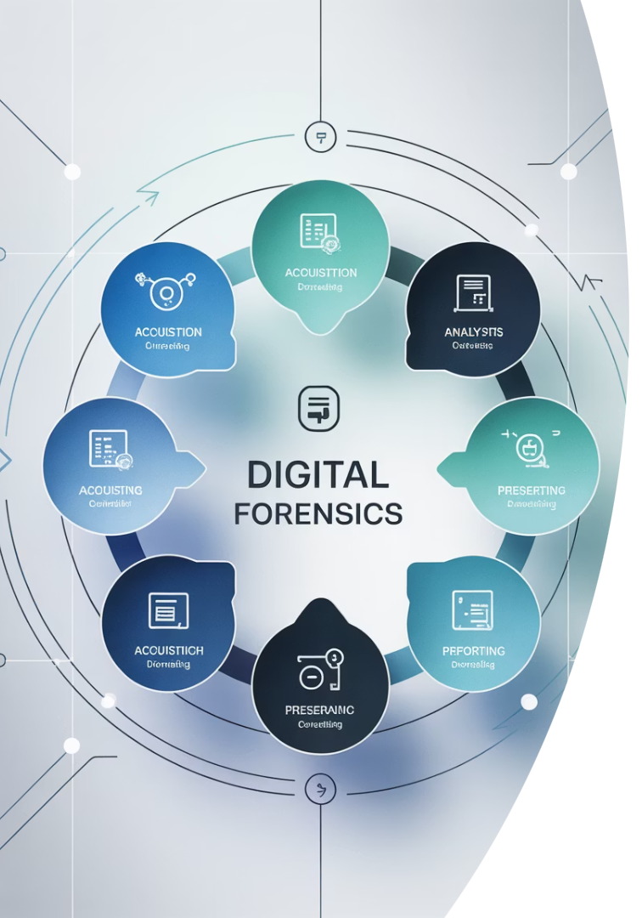




Key Responsibilities and Workflow
Identification
Locate potential evidence sources across diverse digital devices and media.
Acquisition
Securely collect data without altering original evidence.
Analysis
Reconstruct events and attribute actions using specialized tools.
Documentation
Maintain meticulous chain of custody throughout the entire process.

Slide 4






NIST and Digital Forensics
Tool Validation
Rigorous testing ensures forensic tools produce reliable results.
Guidelines Development
NIST SP 800-86 and related publications establish examination standards.
Research Contributions
Ongoing studies advance data integrity and forensic methodologies.
The National Institute of Standards and Technology plays a crucial role in digital forensics credibility by setting standards that ensure evidence reliability and process trust.

Slide 5

Computer Forensics: Collection
Identify and Isolate
Document the scene. Photograph all connections before disconnecting devices.
Prevent remote wiping by isolating from networks.
Protect Original Evidence
Deploy write-blockers to prevent accidental modification.
Capture volatile memory before powering down systems.
Document Everything
Record device status, timestamps, and physical context.
Establish initial chain of custody documentation.

Slide 6








Staging, Storage, and Preservation
Secure Facilities
Integrity Controls
Evidence is processed in controlled environments with restricted access.
Hash values verify evidence remains unaltered.
Digital signatures authenticate examiner actions.
Anti-static workstations prevent damage to sensitive electronics.
Verification Processes
Physical Safeguards
Regular integrity checks confirm evidence stability.
Climate-controlled storage prevents degradation.
Access logs document all interactions with evidence.
Tamper-evident packaging secures physical media.

Slide 7

Tools in Digital Forensics
Forensic Imaging
Analysis Software
FTK Imager creates perfect evidence copies
Autopsy recovers deleted files and artifacts
EnCase captures data while preserving metadata
AccessData FTK provides comprehensive analysis
X-Ways Forensics offers advanced capabilities
dd command tool for Unix/Linux environments
Mobile Forensics
Cellebrite UFED extracts smartphone data
Magnet AXIOM recovers app artifacts
Oxygen Forensic Detective analyzes cloud data

Slide 8





Summary and Future Trends
Evolving Expertise
Digital examiners blend technical skills with legal knowledge for court-admissible results.
Standards-Based Practice
NIST frameworks ensure consistent, reliable forensic processes across the field.
Emerging Challenges
Cloud forensics, IoT devices, and AI-powered systems create new investigation frontiers.
Continuous Education
Ongoing training keeps examiners current with evolving technologies and techniques.

